Slide 1
SONG
POPULARITY
PREDICTION
Open IIT Data Analytics
Team 46

Slide 2
Index
01
02
03
04
05
06
Introduction
Workflow
Exploratory Analysis
Feature Correlation
Approach and Models
Final Approach

Slide 3
01
INTRODUCTION

Slide 4
Introduction
A major record label wants to purchase the rights to a music track.
We are required to predict the popularity of the music tracks based on the features provided in the dataset.
For the wrong prediction, bidding will be successful only if we bid on a less popular music track at the cost of a more popular music track. Vice versa is not possible.
We used a number of machine learning algorithms to detect the popularity level of a song.

Slide 5
Classification
POPULARITY | BID PRICE | REVENUE
VERY HIGH 5 10
HIGH | 4 | 8
AVERAGE 3 6
LOW | 2 | 4
VERY LOW 1 2

Slide 6
02
WORKFLOW

Slide 7
Workflow
Revenue Optimization using Final Model
Approach and Model Training
Exploratory Analysis
Data Engineering
Raw Data

Slide 8
03
EXPLORATORY ANALYSIS

Slide 9
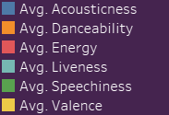
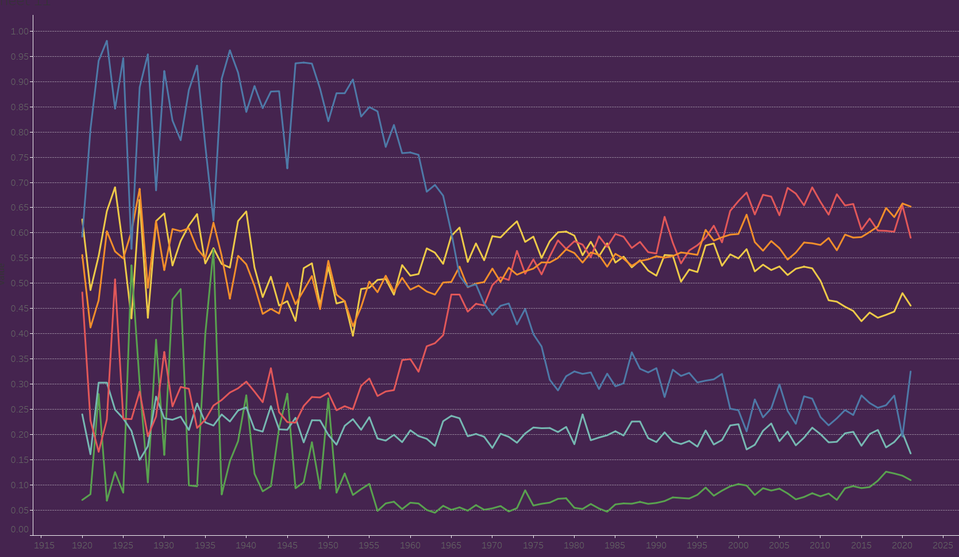
Audio Characteristics over the years

Slide 10
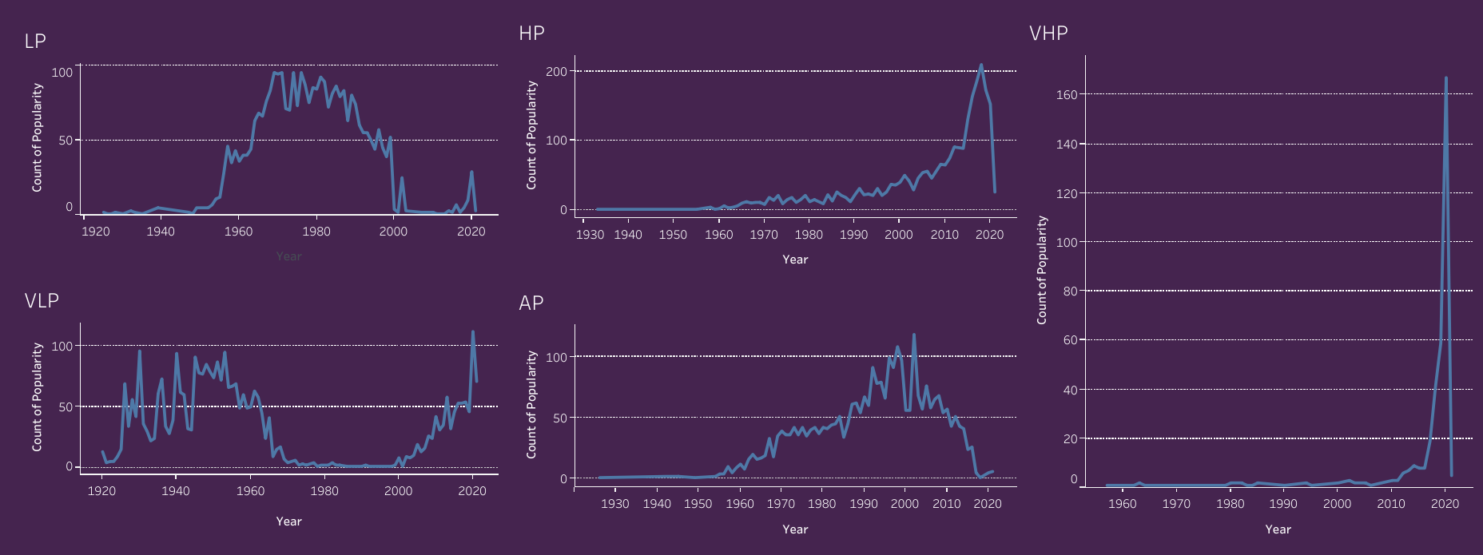
Popularity vs Year

Slide 11
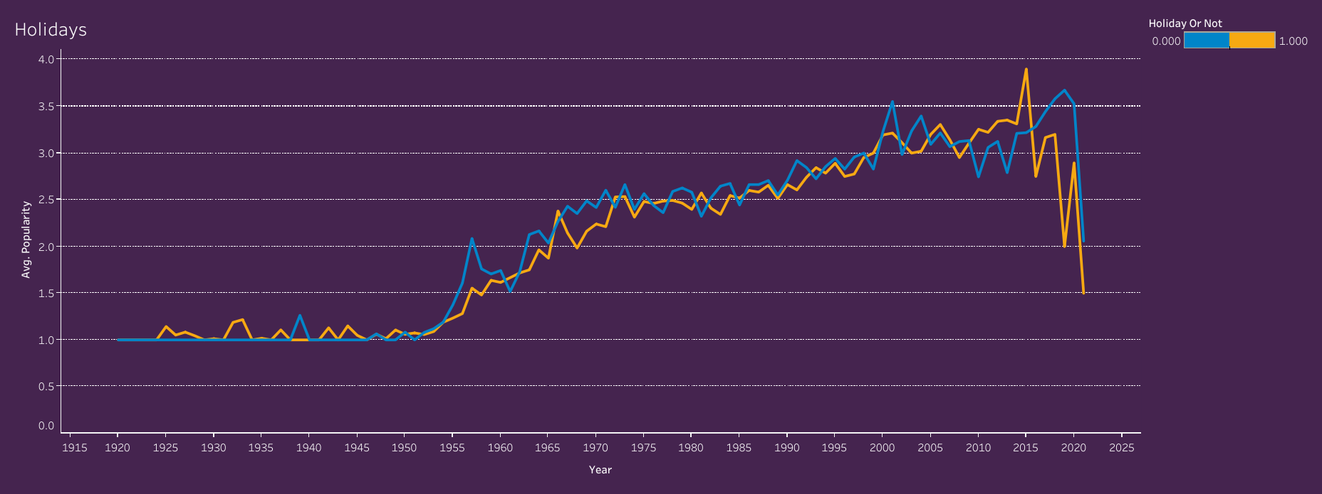
Holidays

Slide 12
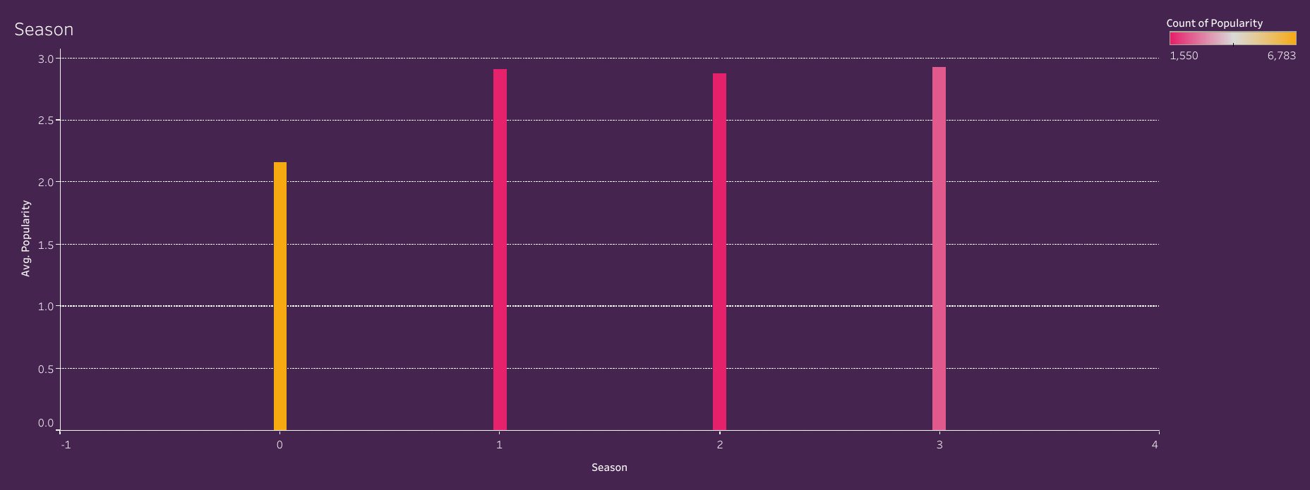
Season

Slide 13
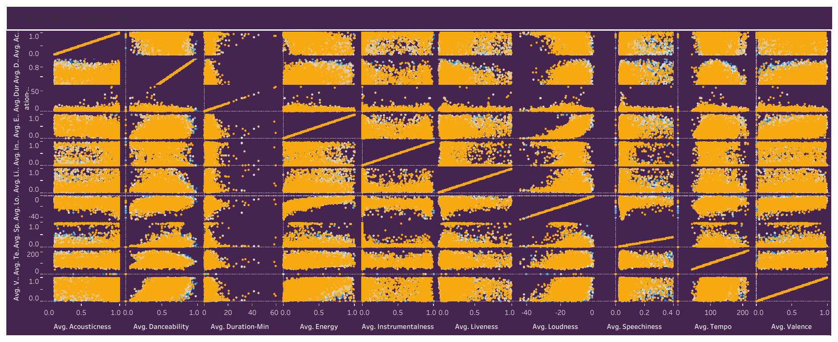
SPM All

Slide 14
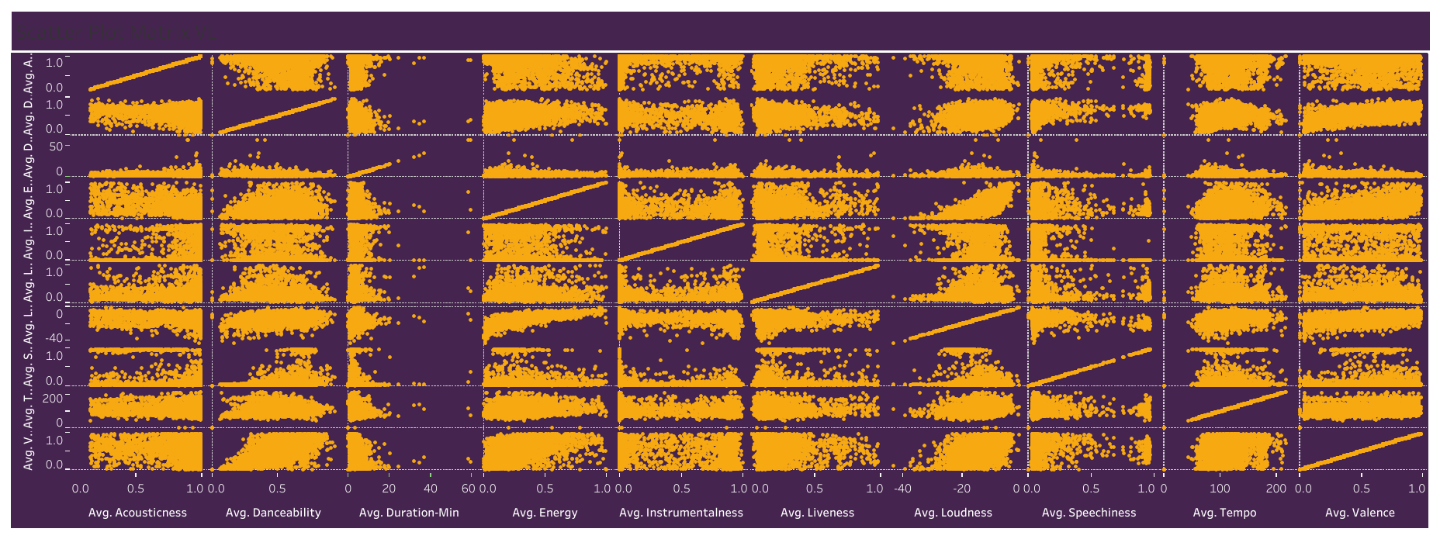
SPM VL

Slide 15
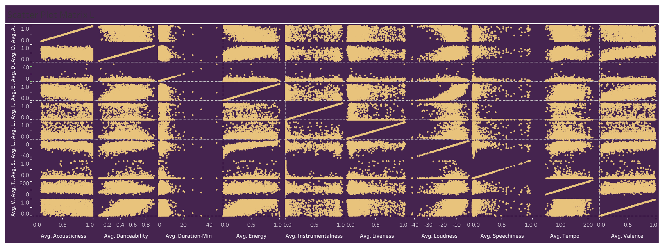
SPM L

Slide 16
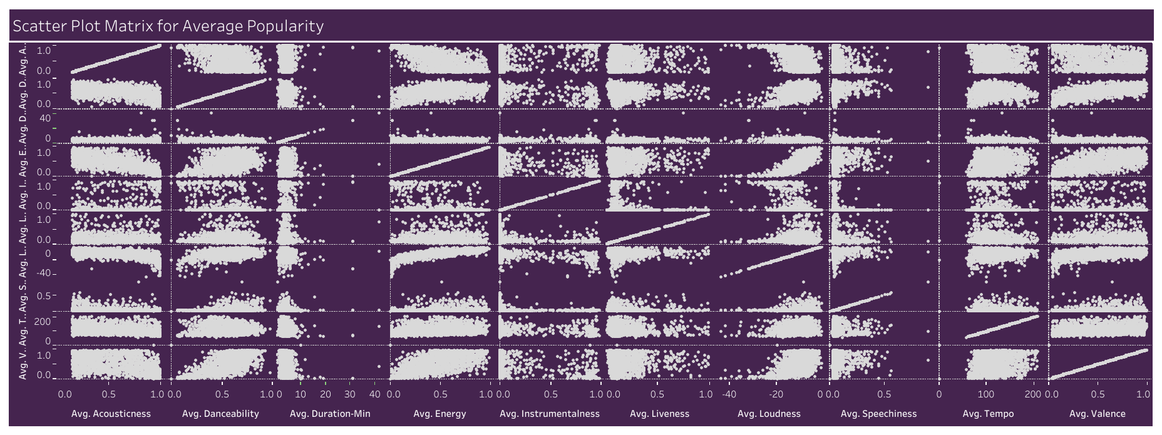
SPM A

Slide 17
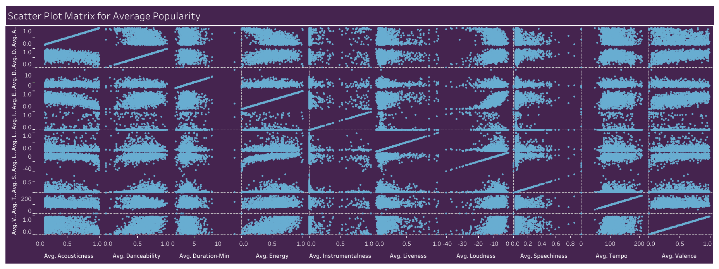
SPM H

Slide 18
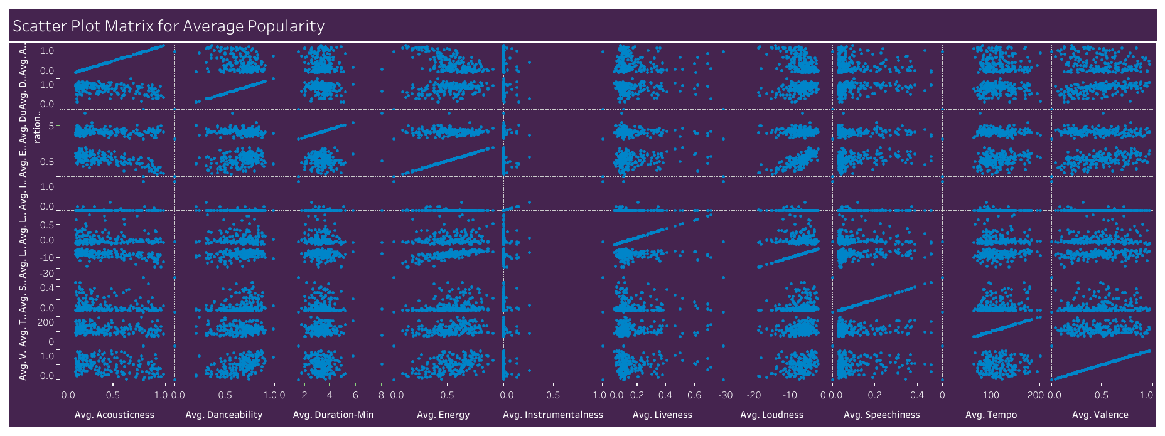
SPM VH

Slide 19
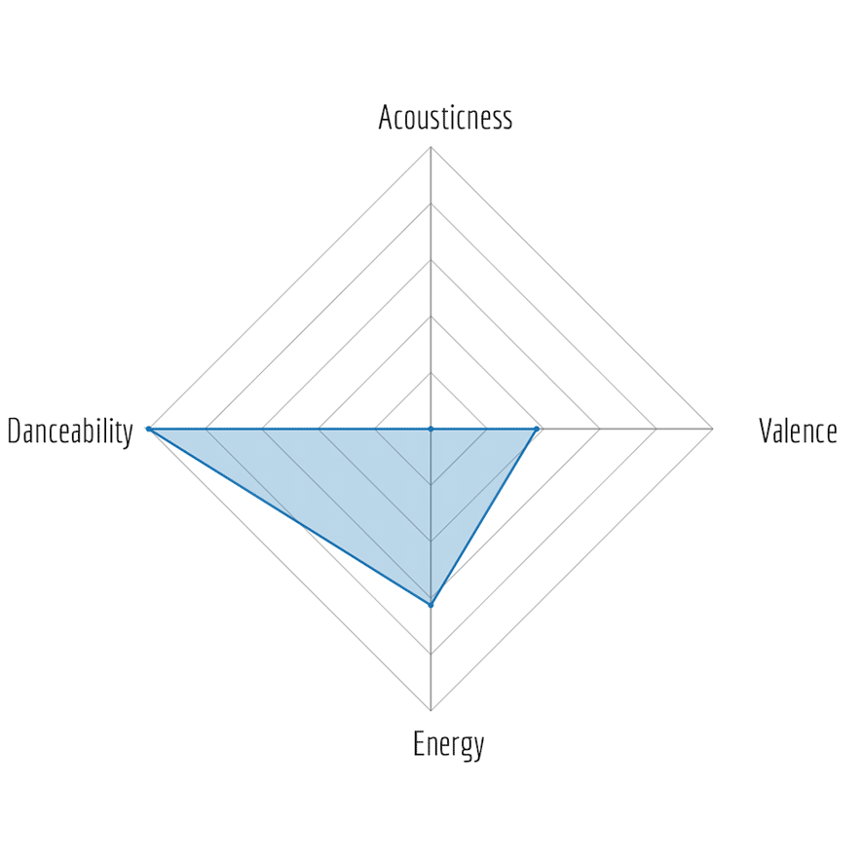
Radar Charts

Slide 20
04
FEATURE CORRELATION

Slide 21
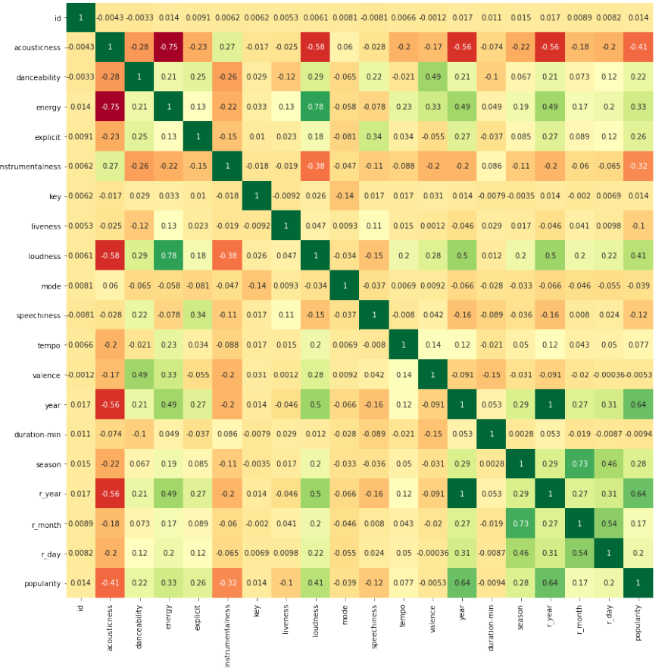
Heat Map

Slide 22
05
APPROACH AND MODELS

Slide 23
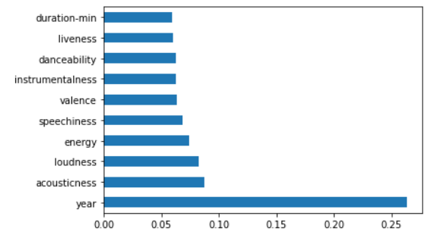
Random Forest:
Parameters Used : Feature Importance:
n_estimators = 500
max_features = 11
min_samples_split = 2
Model Performance(on evaluation set of size 3057 songs):
The model was able to use $5762(in 10k) out of 7642.5 maximum bidable amount, and obtained a revenue of $10251(in 10k).

Slide 24
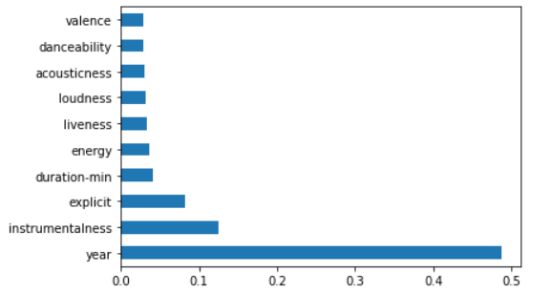
XG Boost:
Parameters Used: Feature Importance:
learning_rate = 0.1
max_depth = 5
n_estimators = 500
Model Performance(on evaluation set of size 3057 songs):
The model was able to use $5679(in 10k) out of 7642.5 maximum bidable amount, and obtained a revenue of $10156(in 10k).

Slide 25
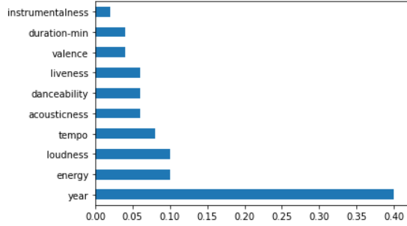
Ada Boost:
Parameters Used: Feature Importance:
Learning_rate = 0.4
base_estimator= Decision Tree Classifier
n_estimators=200
Model Performance(on evaluation set of size 3057 songs):
The model was able to use $5650(in 10k) out of 7642.5 maximum bidable amount, and obtained a revenue of $9876(in 10k).

Slide 26
06
FINAL APPROACH

Slide 27
Problem
Solution
Our models were not optimizing in terms of bid value because of which the whole money was not getting utilised. Via confusion matrix, reason turned out to be a case of under-classification.
We took the ceil of the average of the three models which helped us in achieving a higher revenue.

Slide 28
Our Predictions
Very Low Popularity
Low Popularity
Average Popularity
High Popularity
Very High Popularity
960 Songs
1135 Songs
1035 Songs
719 Songs 151 Songs

Slide 29
Thanks!

